Slide 1
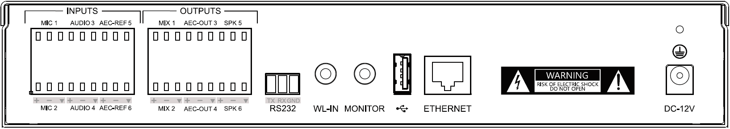


Slide 2

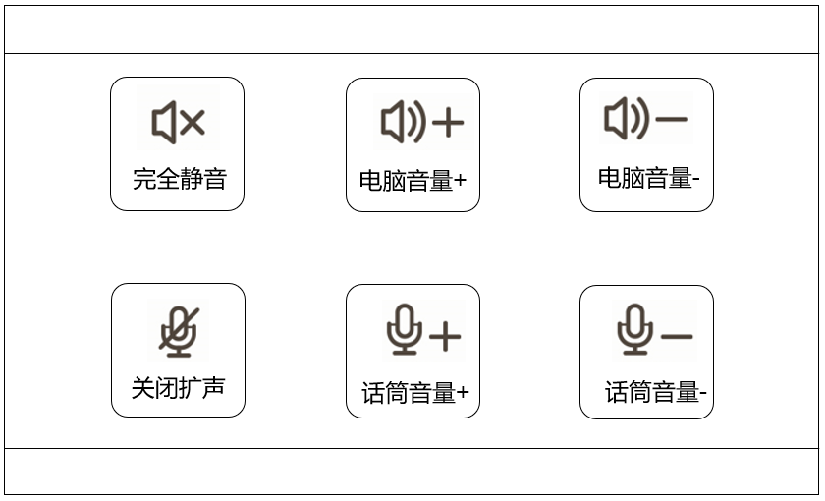


Phantom powered mic
Interactive host
Wireless mic
Monitor headphones
Power Supply
1
4
6
9
10
13
2
3
5
7
8
11
12
Courseware
Recording
Active Speaker
Control panel
OPS/PC
Configuration

Slide 3
➊
➋
➌
➍
➎
➏

Slide 4
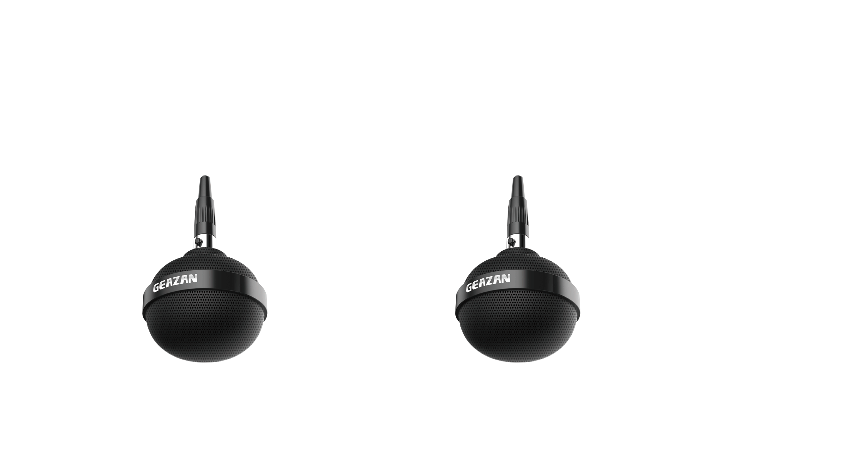
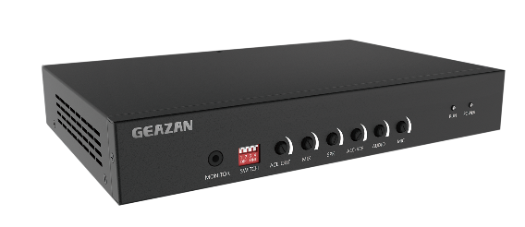

Automatic Echo Cancellation

Automatic Noise Suppression

Automatic Gain Control

