Slide 1
  PoE Extending Solution for CCTV Systems

Slide 2

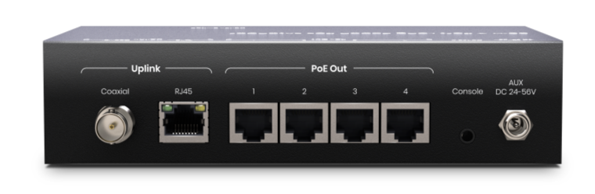
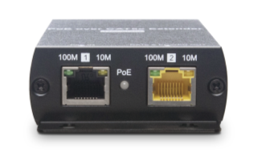
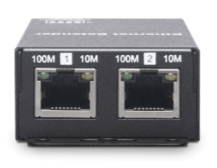
Notes:
IP09 series includes IP09, IP09PT, IP09PR, and IP09PH that support up to 800M transmission distance, up to 100Mbps bandwidth, and up to 120W power. You can meet the requirements for different scenarios using different models.

Slide 3
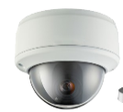
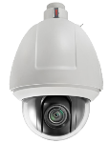

90W 4 Port Long Reach PoE Extender over CAT5e 800M
Overview
IP09PHK is a 90W PoE-switch-like device but can send the PoE signal over up to 800M and split it into 4 signals for 4 PoE devices. It can perfectly work with PoE cameras to establish an advanced CCTV system used in large scale spaces, such as road intersections, supermarkets, amusement parks, parking garages and so on.
IP09PH

Slide 4

PoE over CAT5e Extender
Overview
IP09P is a point-to-point PoE extender that supports IEEE 802.3 at, 802.3 af, 802.3 bt standard and can use a single Ethernet cable (CAT5e, CAT6, CAT7) to transmit PoE signal and provide up to 90 watts of power for a remote PoE device. The PoE extender can be perfectly used in a professional CCTV system to connect a remote PoE camera with PoE switch with a plug-and-play installation.
IP09P

Slide 5
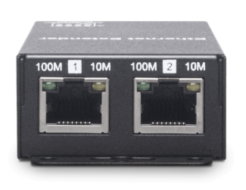
Ethernet over CAT5e Extender
Overview
IP09 is an Ethernet extender (or Lan extender) that can break the transmission limit of Ethernet cable(100M or 328 feet) to transmit the signal for up to 800M. The extender can be perfectly used in a CCTV system, home network, access points and so on.
‍
IP09

Slide 6
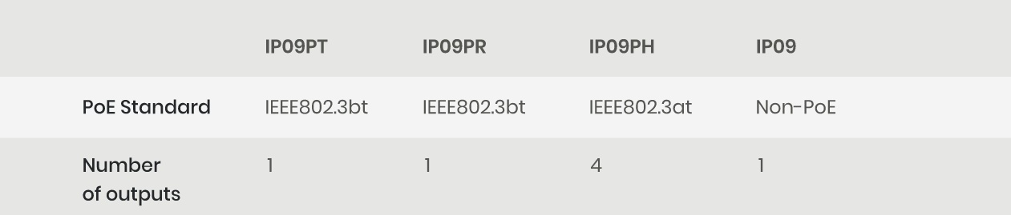
Model Comparison
Notes:
Combine different TX (IP09PT/ IP09PH) and RX (IP09PR/ IP09) to perform accordingly.

Slide 7
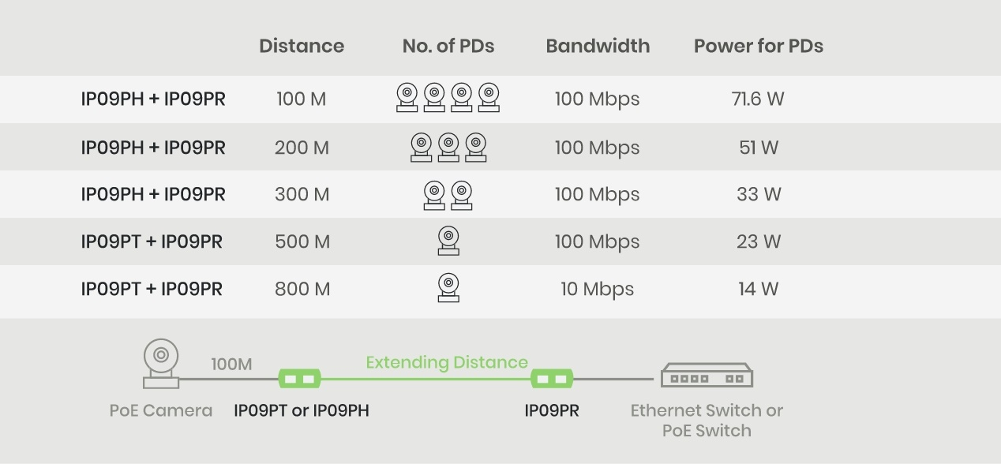
Comparison
Notes:
Power source from IP09PR or PoE switch.

Slide 8
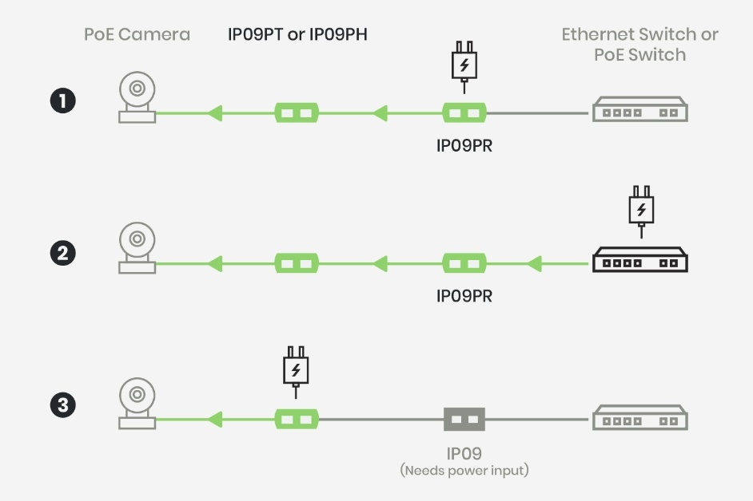
Flexible Power Sourcing Options
Notes:
You can choose a preferable way to provide power for PDs, based on your project requirement.

Slide 9
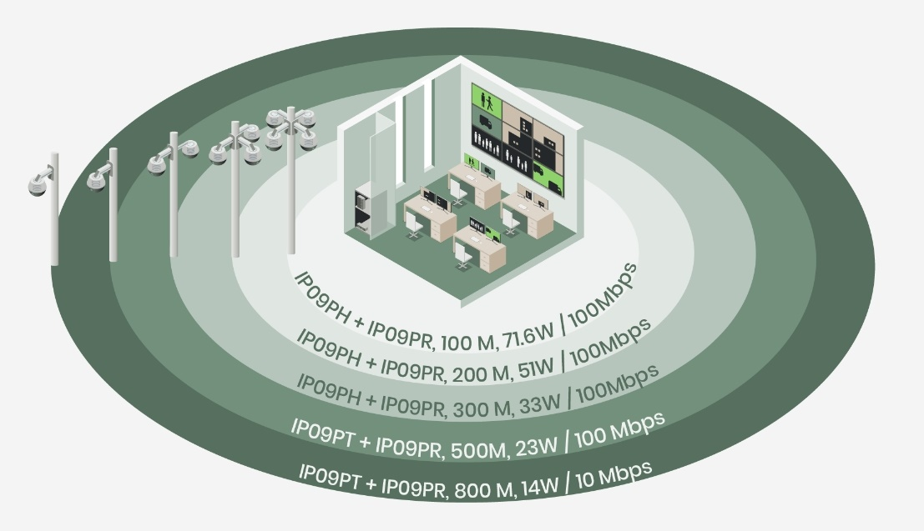
Use different combinations to expand PoE cameras to every corner
Notes:
You can choose a preferable way to provide power for PDs, based on your project requirement.

Slide 10

Use different combinations to expand PoE cameras to every corner
Notes:
You can choose a preferable way to provide power for PDs, based on your project requirement.

Slide 11
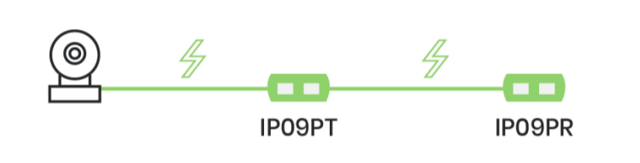
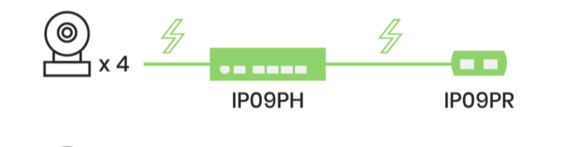
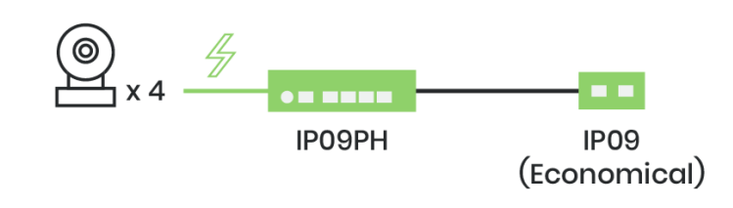
Customizable Solutions
Use IP09PT and IP09PR to achieve point-to-point transmission.
Use IP09PH and IP09PR to extend 4 PoE signals over an Ethernet cable, allowing you to save time and cost for the installation.
Use IP09PH/ IP09PT and IP09 for long distance, high power, and high bandwidth transmission.

Slide 12

Real-life PoE over Coax Application
IP09 series also has coaxial version that allows you to upgrade CCTV cameras from analog to PoE without replacing the existing coaxial cables. Click the button below to explore how it can considerably save your time and budget.
Explore how it can considerably save your time and budget.

Slide 13
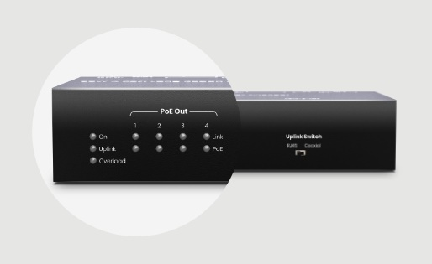

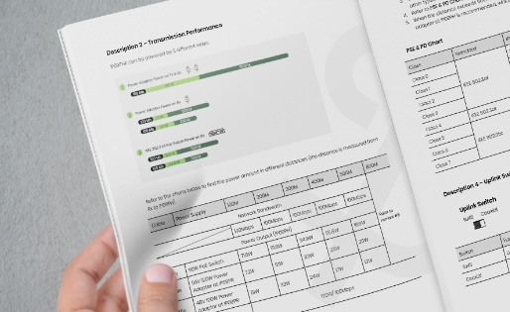
Features
Clear LED Indication
User-friendly Installation
Detailed Reference Data
Built-in multiple LED indicators for installers to instantly identify the current connection status and to take necessary adjustment.
IP09 series is a mountable gadget that can be fixed on wall or a platform.
We provide detailed test report that can help you customize solutions for projects.

Slide 14
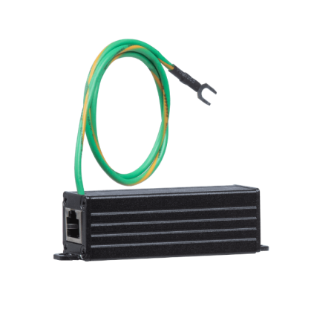
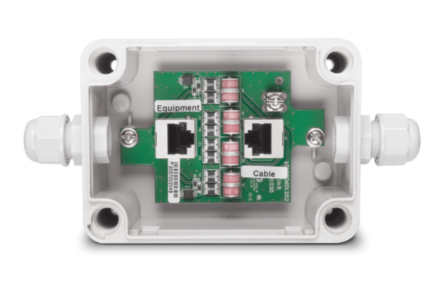
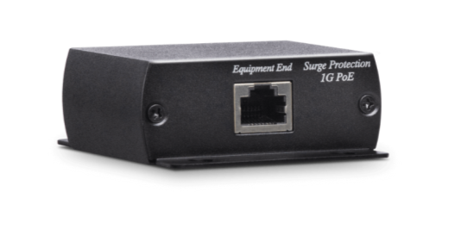
PoE Surge Protector Series
SP006P
SP006PH
SP006PHO
We also offer a full range of PoE surge protectors to protect your expensive PoE devices.

Slide 15
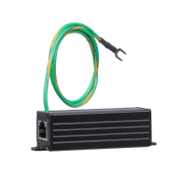
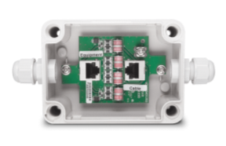
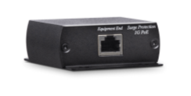
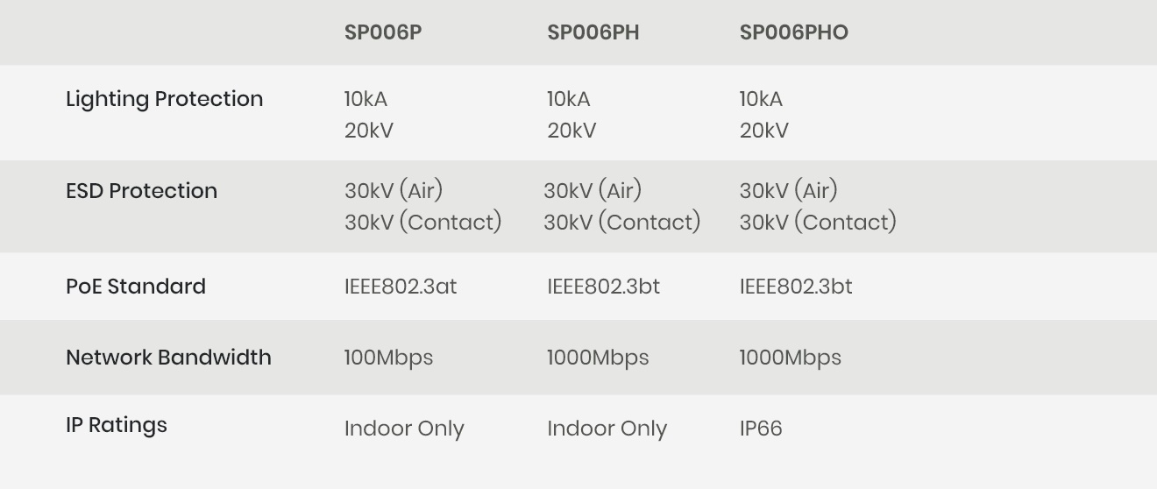
PoE Surge Protector Series

Slide 16
www.sct.com.tw
service@sct.com.tw
(02) 2218-6886

