Slide 2
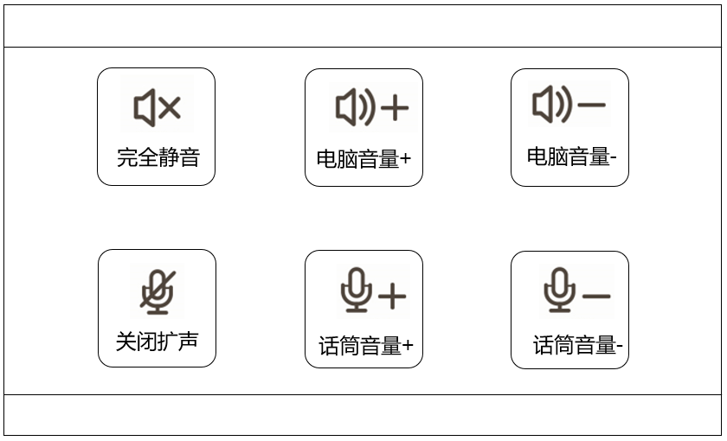
Phantom powered microphone
Interactive host
Wireless mic
Monitor headphones
Power supply
……
1
……
3
5
7
8
12
2
4
6
9
10
11
Amplifier
Courseware
Recording
Speaker
Control terminal
Configuration
OPS/PC

